Slide 1
ARCTEQ COMPANY PRESENTATION
Arcteq Relays Ltd
Vaasa, Finland

Slide 2
HISTORY

Slide 3
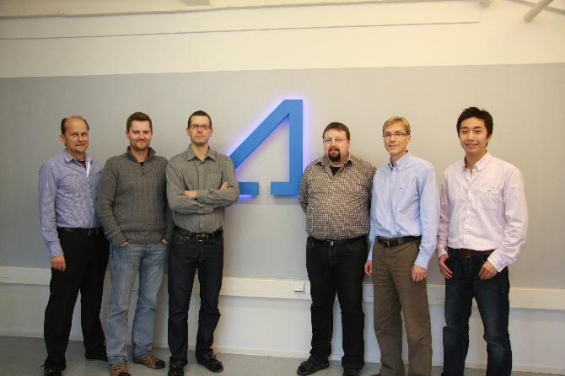

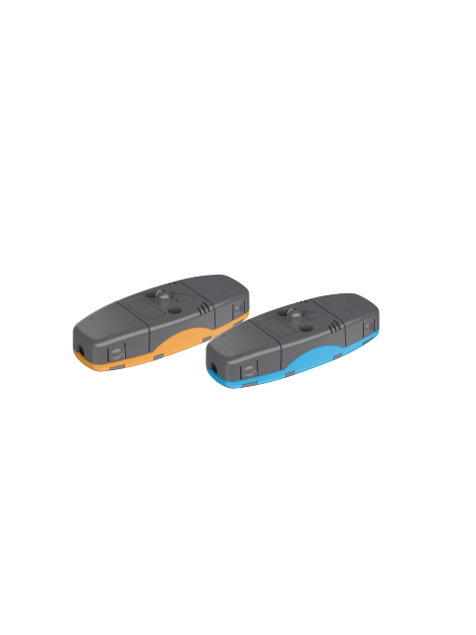
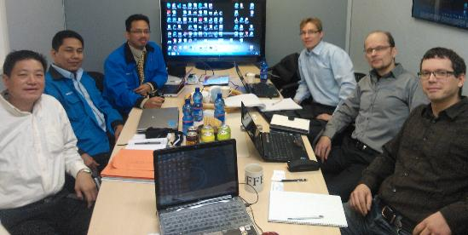
Company is founded as spin off from Vamp and ABB to address market need for independent relay supplier
2010
First AQ-100 series installations take place in Colombia and Finland
2011
The first AQ-F201 relays installed in Sweden
2012
Launch of AQ-02 sensor.
The first light, current & pressure based arc flash protection systems installed.
ISO 9001 obtained.
2013
Arcteq integrates 0.2 accuracy metering in the protection relay and patents the measurement technology of AQ-200 series.
Intermittent earth fault protection field tested and patented globally.
2014

Slide 4
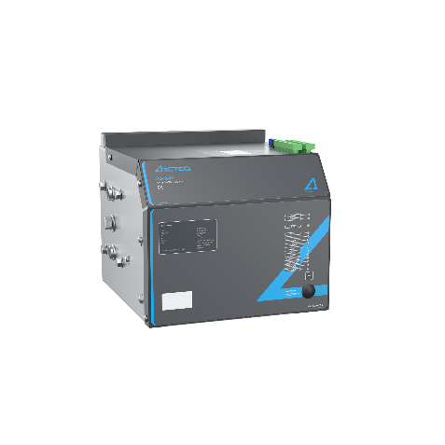
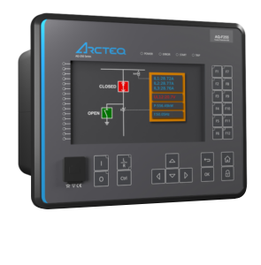
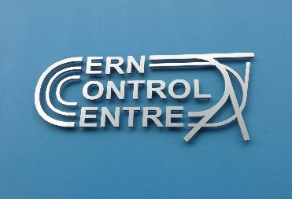
Arcteq is approved by TNB Malaysia, the largest utility in Southeast Asia, followed by large scale AQ 100 series deliveries to double busbar systems with selective feeder tripping in 33/11 kV substations.
2015
The launch of Arc quenching device AQ-1000 for low voltage switchgear. The device can be re-activated for multiple operations and testing. Technology is patented world-wide.
Ensto becomes industrial investor in Arcteq Relays.
2016
The launch of AQ-250 series.
Global co-operation with Siemens in arc flash protection starts
2017
The first 5-year frame contract with CERN for AQ-250 series
2018
The launch of Customer Support Portal
Collaboration with Siemens in MV arc quenching - SiQuench that is now being integrated in Arcteq portfolio as AQuench
2019

Slide 5
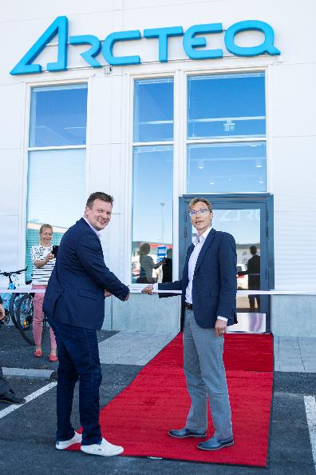
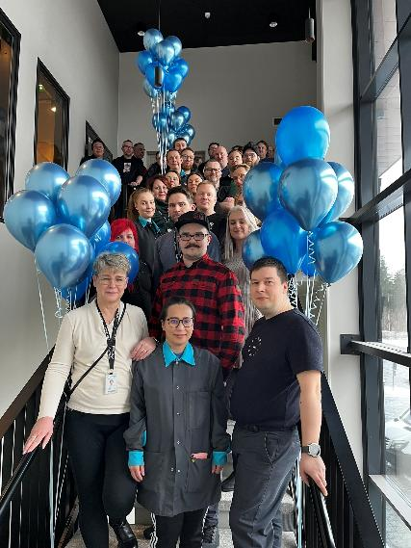
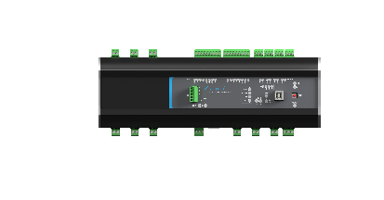
Move to new state of the art premises. Covid stalls the growth.
2020
Opening of Arcteq Relays Ltd (branch) in Dubai.
Arcteq becomes part of Ensto Group, the international technology company and family business
2021
International expansion continues, Arcteq products actively sold in more than 50 countries
2022
Year of fast growth (40%), factory and office expansion.
Opening of Ensto/Arcteq North America.
The 2nd 5-year frame contract with CERN for AQ-250 series
2023
Expansion of portfolio with AQ-50 fault detection devices through integration of Ensto Protrol AB.
Rapid growth of arc quenching device business.
Arcteq reaches more than 100 000 delivered arc flash protection devices.
2024

Slide 6

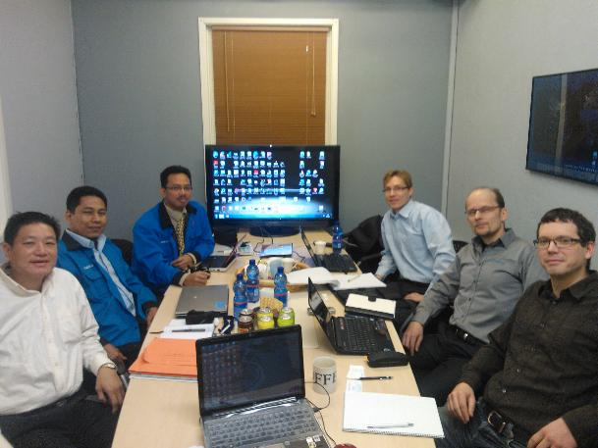
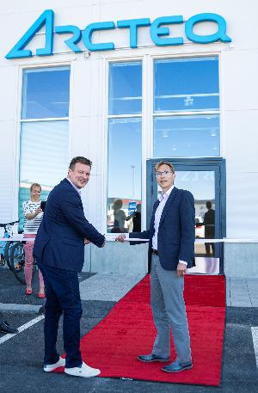
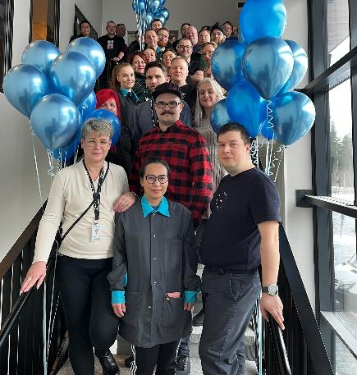
The launch of line protection applications in AQ 250 series.
The launch of Rogowski support in AQ 100 series for easy installation in retrofit projects
2025
Launch of AQ-ONE. Unified protection relay is born.
2026
Powering the next chapter.

Slide 7
ARCTEQ TODAY

Slide 8
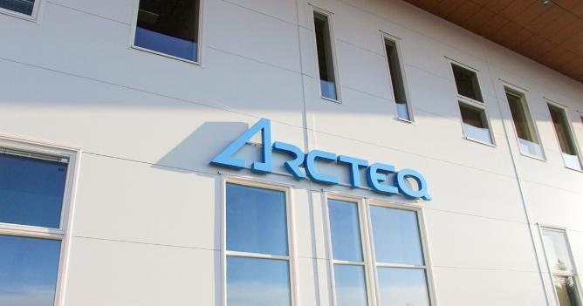
Arcteq in short
Focused manufacturer of protection relays, arc flash protection systems and related technologies
Headquarters and manufacturing in Vaasa, Finland
Global presence through own offices and partner network
We are a team of experts in protection relays and arc flash protection systems
We are part of Ensto group, a Finnish technology company and family business
More than 35 000 protection relays installed worldwide
More than 100 000 arc flash protection relays installed worldwide

Slide 9



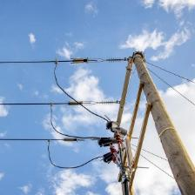
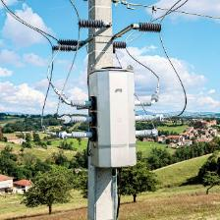
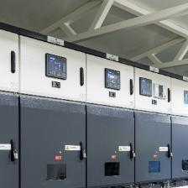
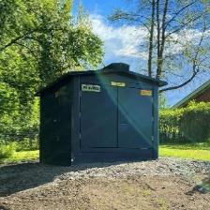




Sustainable Solutions for Electricity Distribution
Strategic priorities Growth | Profitability | Renewal
Business Lines
People
Customers
Line
Accessories
Distribution
Automation
Protection
Automation
and Control
Substations
Values Trust Capital | Winning Together | Creativity
Sustainability

Slide 10
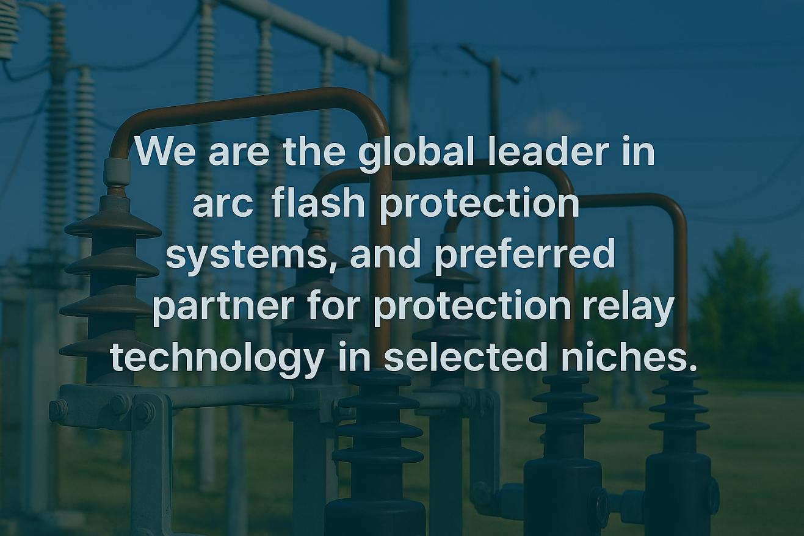
Our vision

Slide 11

Our mission

Slide 12
Global presence
Arcteq Partner
Arcteq Relays Ltd. (Headquarter)
Vaasa, Finland
Ensto Sweden Ab
Arcteq Korea Co. Ltd.
Ensto North America Inc.
Arcteq Relays Ltd. (China)
Arcteq Relays (Branch) Ltd.
Arcteq Brasil
“We offer our partners and customers the best-in- class technical support”
“We build our business on
partnership with customers
who value our unique offering”
Arcteq
Pacific Pty.

Slide 13
OUR TECHNOLOGY

Slide 14
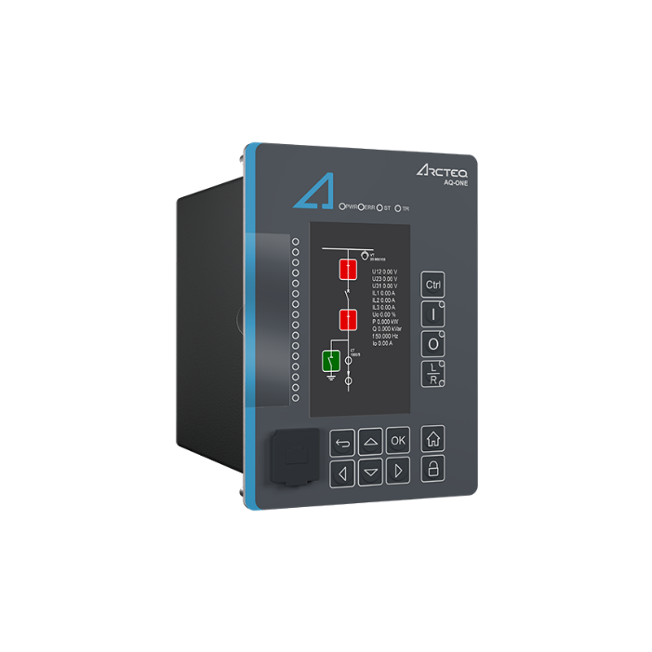
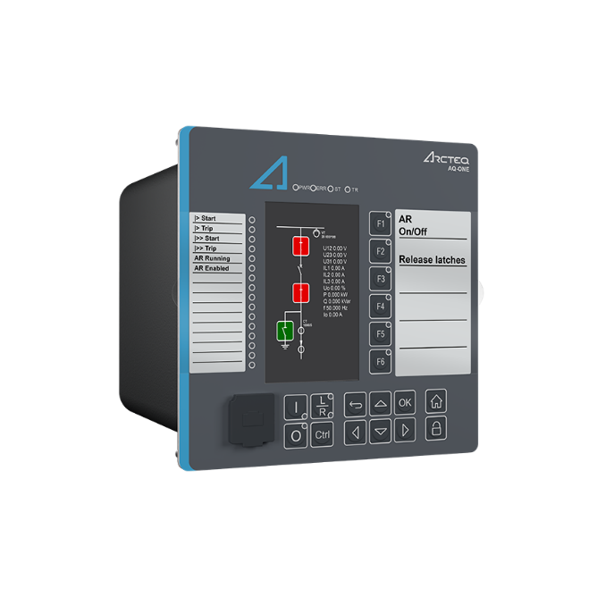
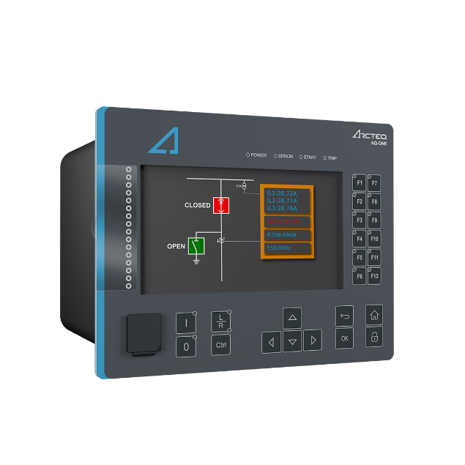
Protection relays – AQ-ONE
The most accurate protection relay in the world - based on the foundation of AQ 200 series
One relay - Three sizes - Unlimited applications.
Optimized for applications below 150 kV

Slide 15
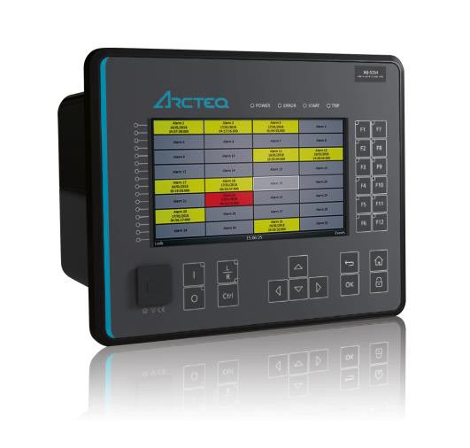
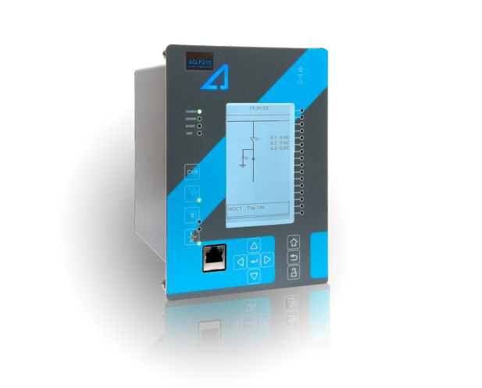
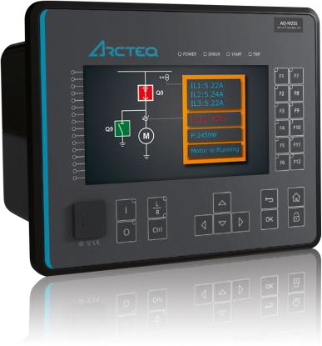
Protection relays – AQ 200 series
More than 35 000 devices installed worldwide
Feeder, motor, transformer, generator and line protection and control applications

Slide 16
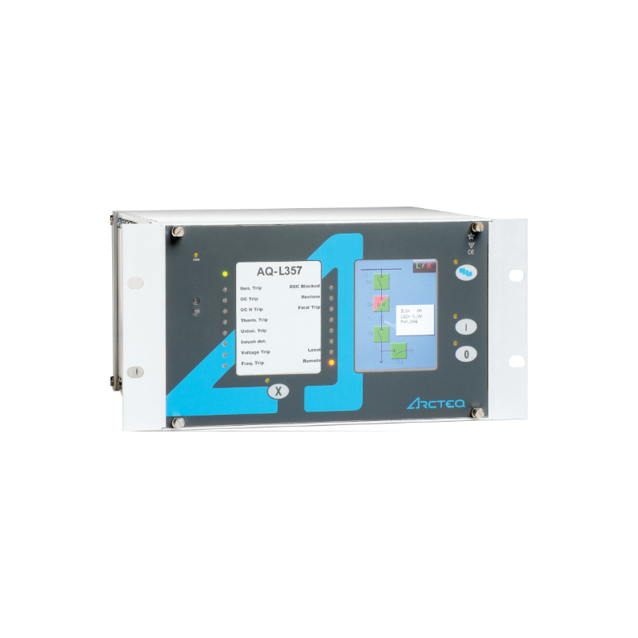
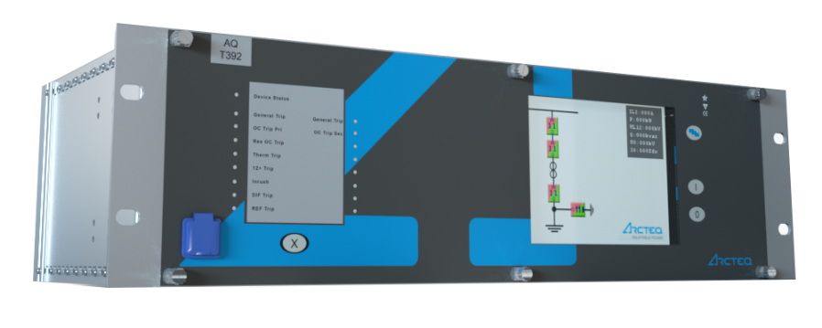
Protection relays – AQ 300 series
Transmission protection relays, optimized for applications > 150 kV
Line, busbar, transformer protection and control
Several approvals for transmission companies worldwide for more than 15 years

Slide 17
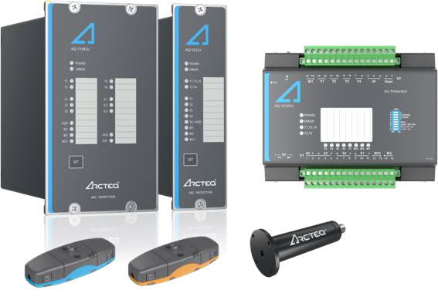
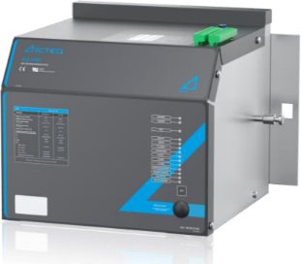
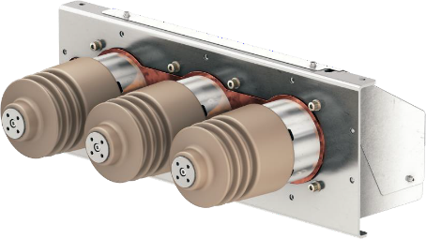
Arc flash protection – AQ 100 series
More than 100 000 relays installed worldwide
Medium and low voltage product lines
Resettable and testable arc quenching devices for medium and low voltage

Slide 18
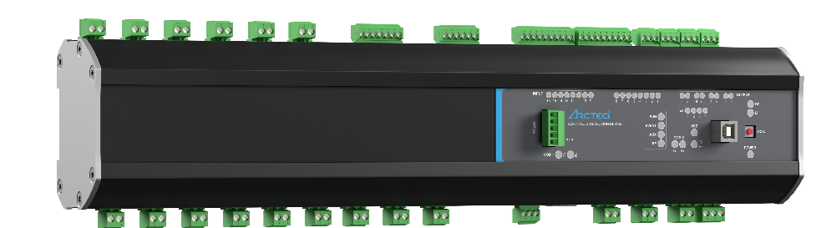
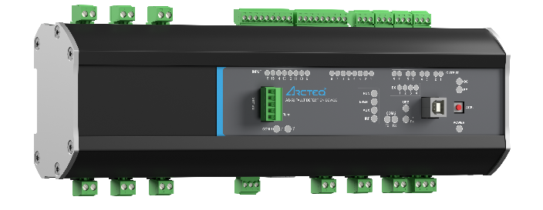
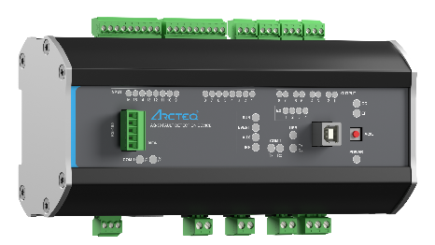
Fault detection – AQ-50
Full secondary substation management with single device
High impedance earth fault detection
Intermittent earth fault detection
Short circuit and unbalance detection
Direct communication to SCADA
Fully automated fault localization, isolation and service restoration (FLISR)
More than 40 000 devices installed for over 20 years

Slide 19
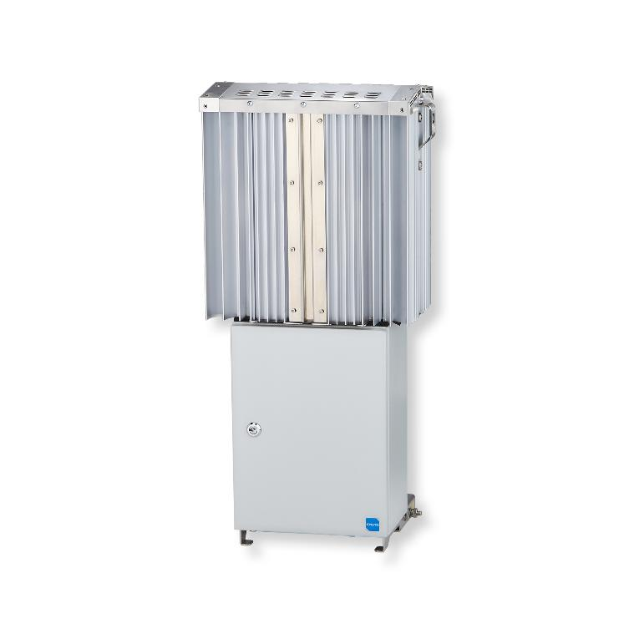
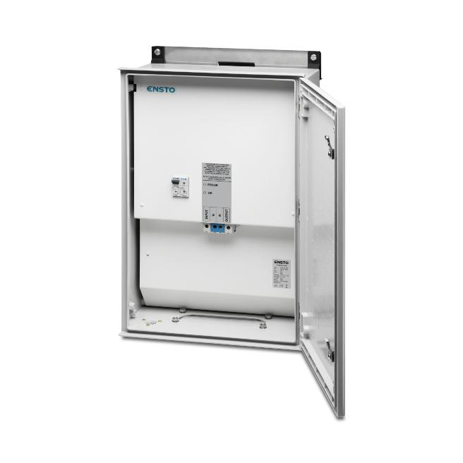
Power quality
Voltage balancer for 400 V networks (3 phase)
Voltage controller for 400 V networks (1 phase)
Correcting unbalance issues caused e.g. by solar and wind power installations in LV network
Cost efficient solution to mitigate imbalance, harmonics and flickers in the LV network.
Improves protection and electrical safety by increasing short circuit currents
Passive solution (zig zag transformer) requiring no maintenance.

Slide 20
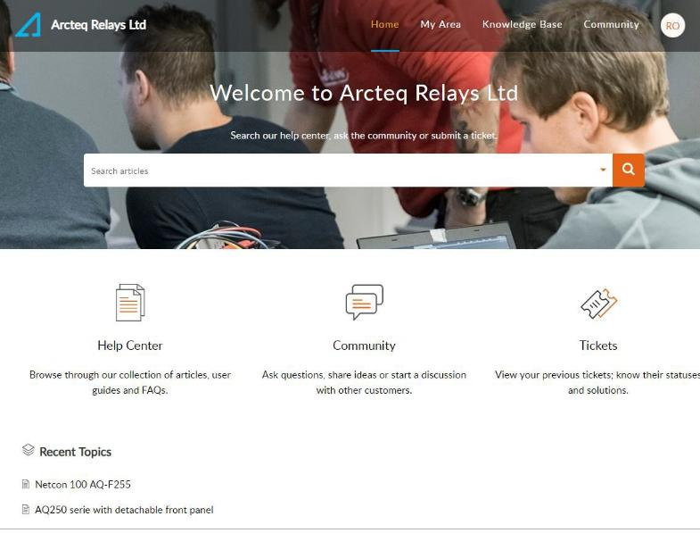
Services
Arcteq offers services through its own skilled personnel and worldwide network of partner
  Simulations of electrical networks
  Short-circuit calculations, setting calculations, fault analysis
  Protection relay and Arc system testing
  Training – Protection and Control Aqademy
  Warranty services, spare parts, local stocking
Technical support: https://support.arcteq.fi/portal/home

Slide 21


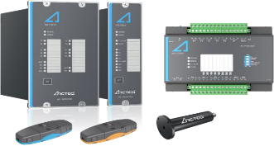
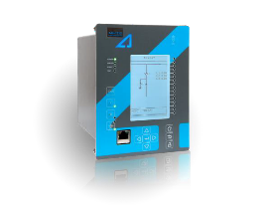
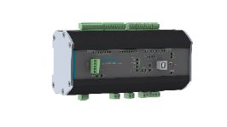
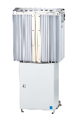
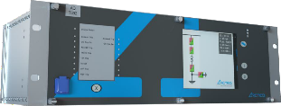
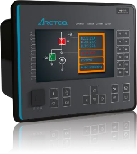

Product portfolio coverage
POWER GENERATION
HV SUBSTATION
400 KV / 110 KV
PRIMARY SUBSTATION
110 KV / 20 KV
INDUSTRIAL
DISTRIBUTION
SECONDARY SUBSTATION
20 KV / 400 V
LOW VOLTAGE DISTRIBUTION
  Generation, transmission & distribution protection relays
  Arc flash protection
  Transmission Protection relays
  Distribution protection relays
  Arc flash protection
  Fault detection devices
  Phase Balancer Voltage Controller

Slide 22
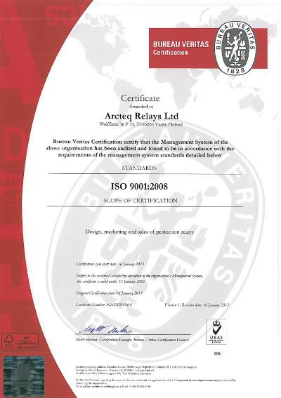
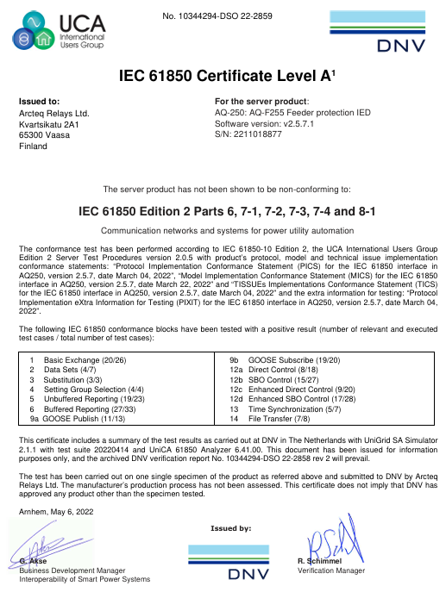
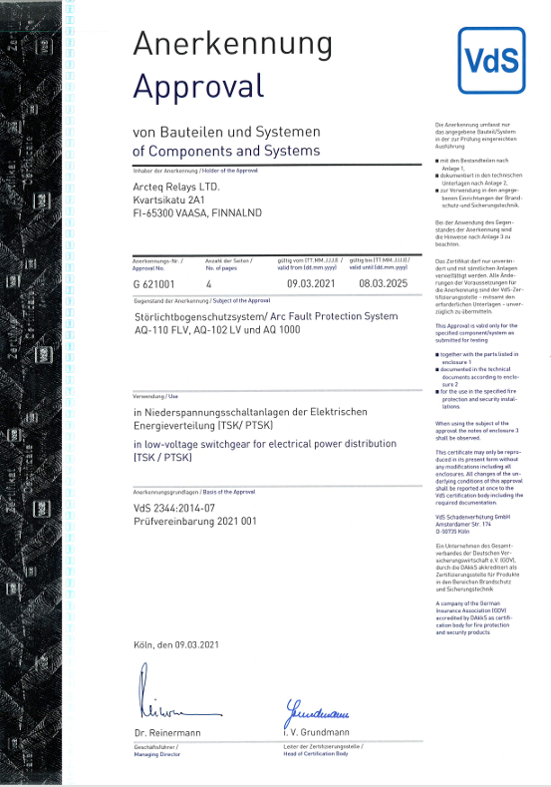
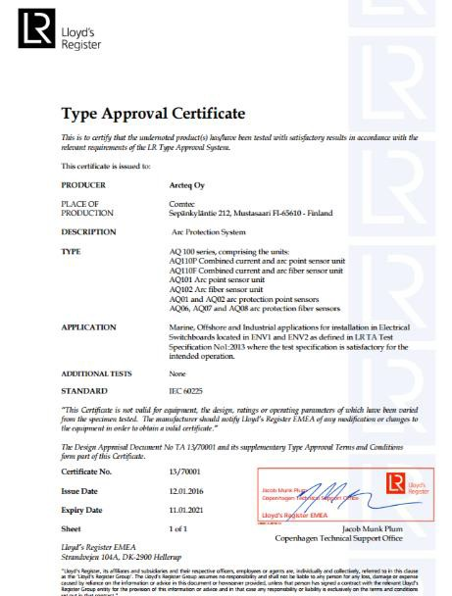
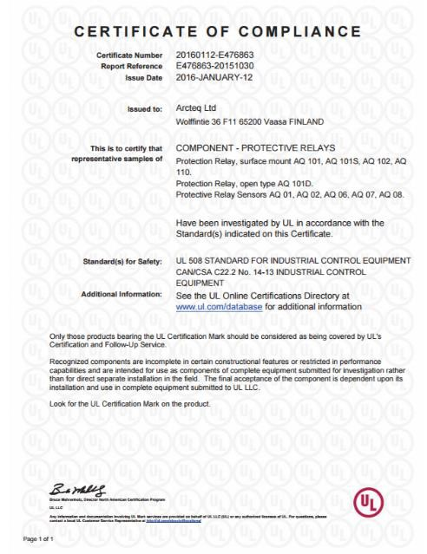
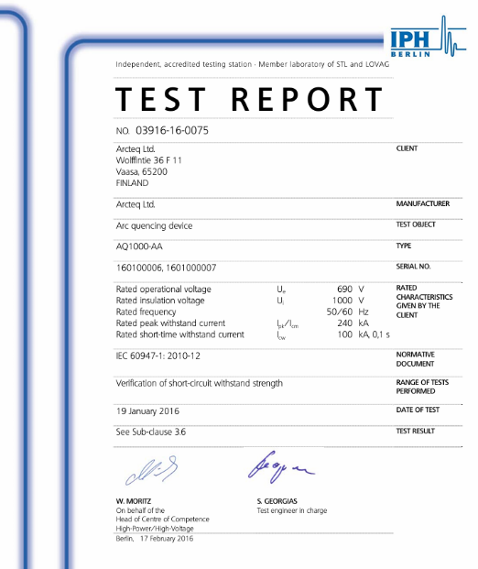
Certifications

Slide 23
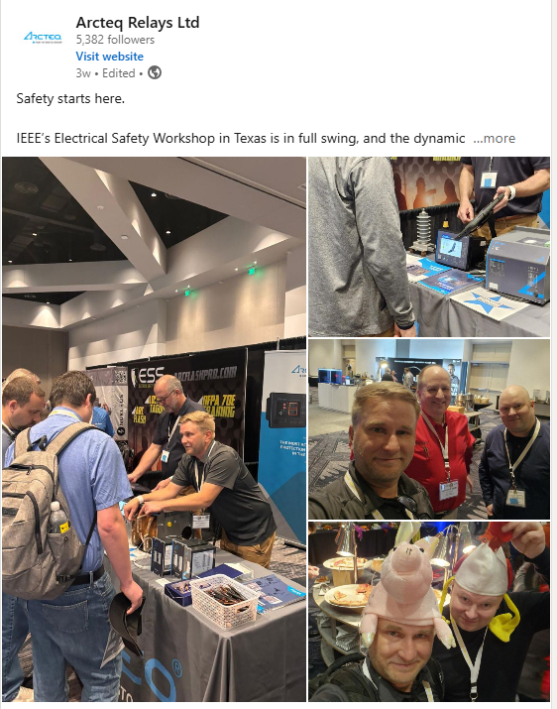
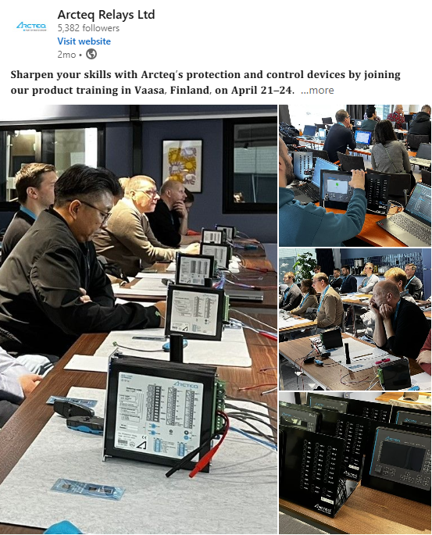
Arcteq in social media
Youtube: videos and webinars
Arcteq Relays Ltd – YouTube
  New Era of Distance Protection is here
  Arcteq AQ-250 - The most accurate protection relay in the world
  Arc flash comparison
  The first ever 65kA open door test
  AQ-1000 Arc quenching device
Linkedin:
https://www.linkedin.com/company/1431752/

